Slide 1
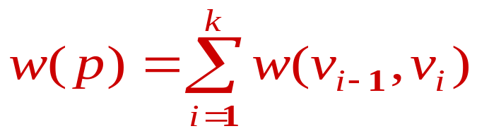
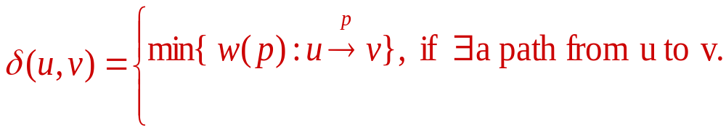
Shortest-path problem
Let G=(V,E) be weighted, directed graph. Let P=<v₀,v₁,…,v_{k}) be a path form v₀ to v_{k}.
The length of the path P is:
Shortest-path weight from u to v：

Slide 2
Shortest-path problems:
Single-source: find a shortest path from a given vertex u to every other vertex v.
Single-destination: find a shortest path from every vertex u to a given vertex v.
Single-pair: find a shortest path from one given vertex u to another given vertex v.
All-pairs: find a shortest path between all pairs of vertices u and v. This can be done by repeating any of the above.

Slide 3
Example
8
6
2
1
1
3
3
16
1
6
7
4
5
10
4
2
4
7
7
5
3
14
A path from 1 to 7.
Path length is 14

Slide 4
Example
8
6
2
1
3
3
16
1
6
7
4
5
10
4
2
4
7
5
3
14
Another path from 1 to 7. Path length is 11.
There are two paths what is the shortest?

Slide 5
Uniqueness of shortest paths
Is the Shortest path necessarily unique?
6
3
6
9
3
9
3
3
2
1
4
2
1
4
0
2
7
0
2
7
3
5
3
5
5
11
5
11
6
6

Slide 6
Single Source Single Destination
Possible greedy algorithm:
  Leave source vertex using cheapest/shortest edge.
  Leave new vertex using cheapest edge subject to the constraint that a new vertex is reached.
  Continue until destination is reached.

Slide 7
Greedy Shortest 1 To 7 Path
8
6
2
1
3
3
16
1
6
7
4
5
10
4
2
4
7
5
3
14
Path length is 12.
Not shortest path. Algorithm doesn’t work!

Slide 8
Shortest Path Properties(1)
Optimal substructure. If the P is the shortest path between s & v, then all sub-paths of P are shortest paths.
  Let P₁ be x-y sub-path of shortest s-v path P.
  Let P₂ be any x-y path.
  w(P₁) ≤ w(P₂), otherwise P
  not shortest s-v path.
x
P₁
y
s
v
P₂

Slide 9
Shortest Path: Properties(2)
Triangle inequality. Let δ(u, v) be the length of the shortest path from u to v.
  If x is one vertex among the path vertices, then, δ(u, v) ≤ δ(u, x) + δ(x, v)
  If x is adjacent to v, then
    δ(u, v) ≤ δ(u, x) + weight(x, v)
u
v
x

Slide 10
Relaxation
Let d[v] be the shortest path from source vertex s to destination vertex v.
let Pred[v] be the predecessor of vertex v along a shortest path from s to v.
Relaxation of an edge (u, v) is the process of updating both d[v] & Pred[v] going through u. That is
if (d[v]>d[u] + w(u,v)) {
d[v] = d[u] + w(u,v);
pred[v] = u; }
Following is an example

Slide 11
Relaxation
Relax(u,v)
u
w(u,v)
S
d[u]
v
d[v]
Initially:
  d[s] = 0;
  d[v] = ∞; for any vertex v≠s.
S
d[v]=9
d[u]=5
2
2
u
v
u
v
d[u]=5
d[v]=6
Relax(u,v)
d[u]=5
u
2
v
u
2
v
d[v]=6
d[v] = 7
d[u]=5

